Slide 1

Project Quack
Presented by
The Bestagons
Notes:
David

Slide 2

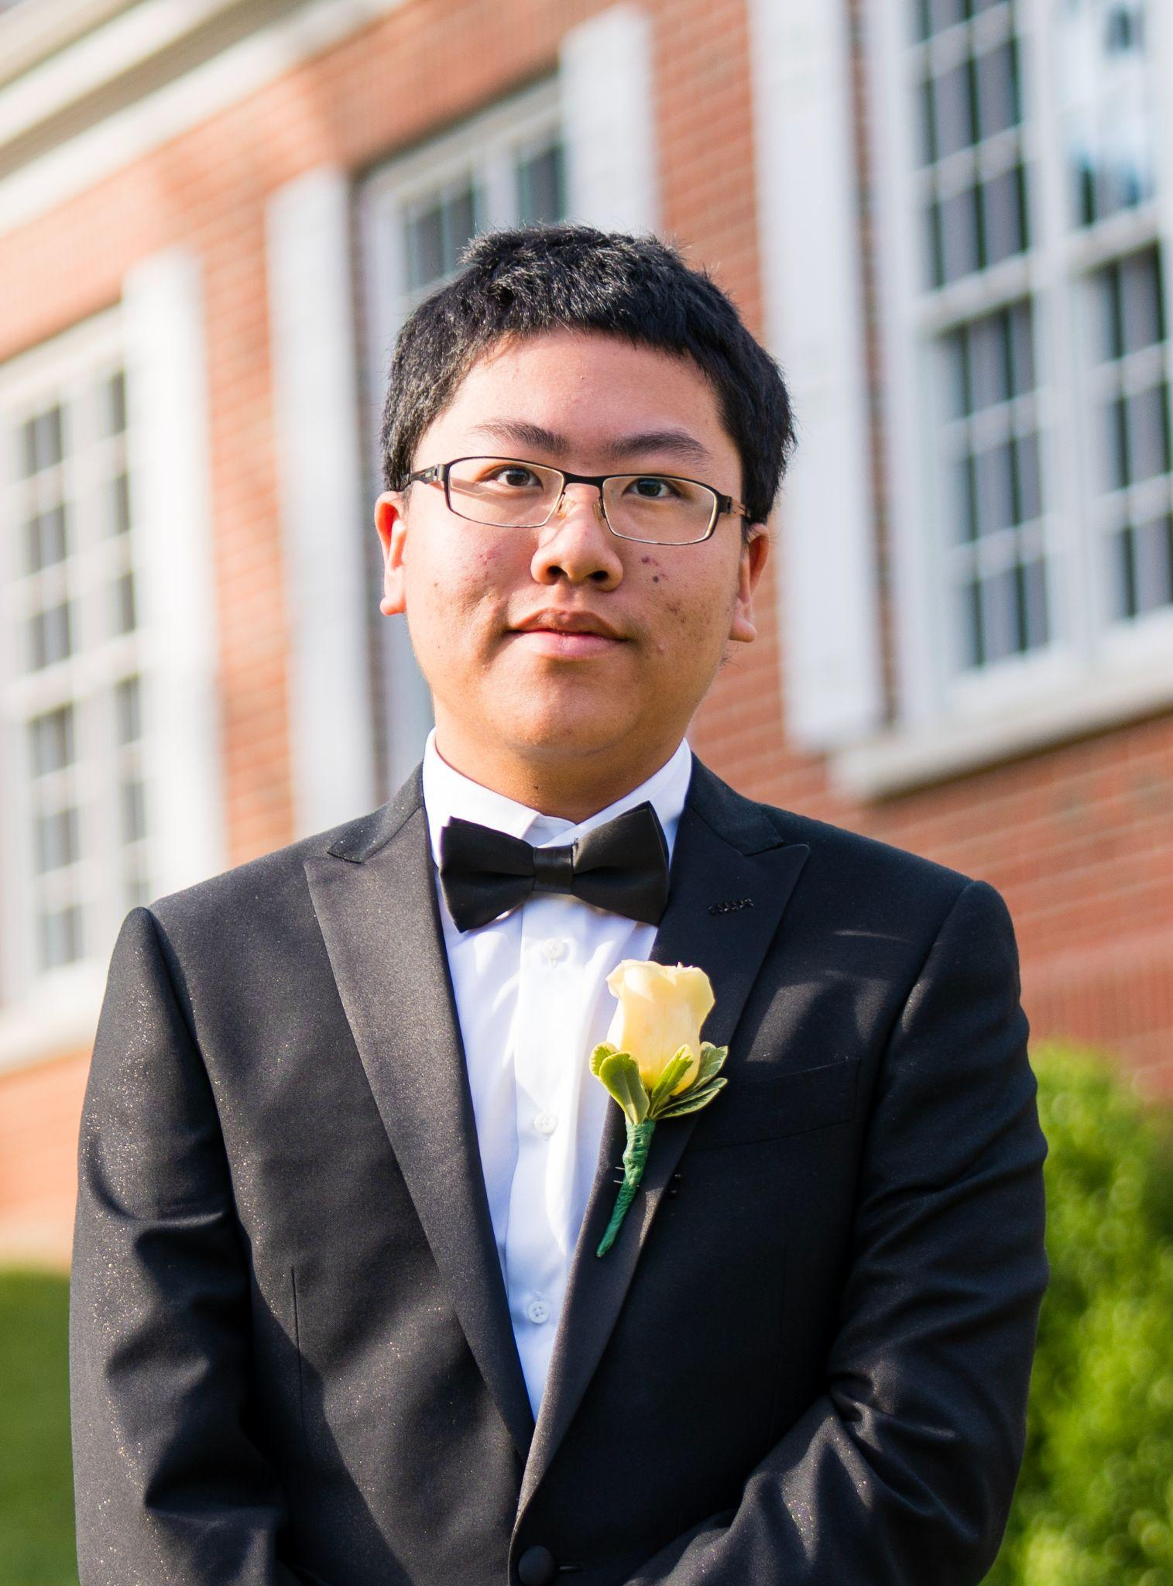

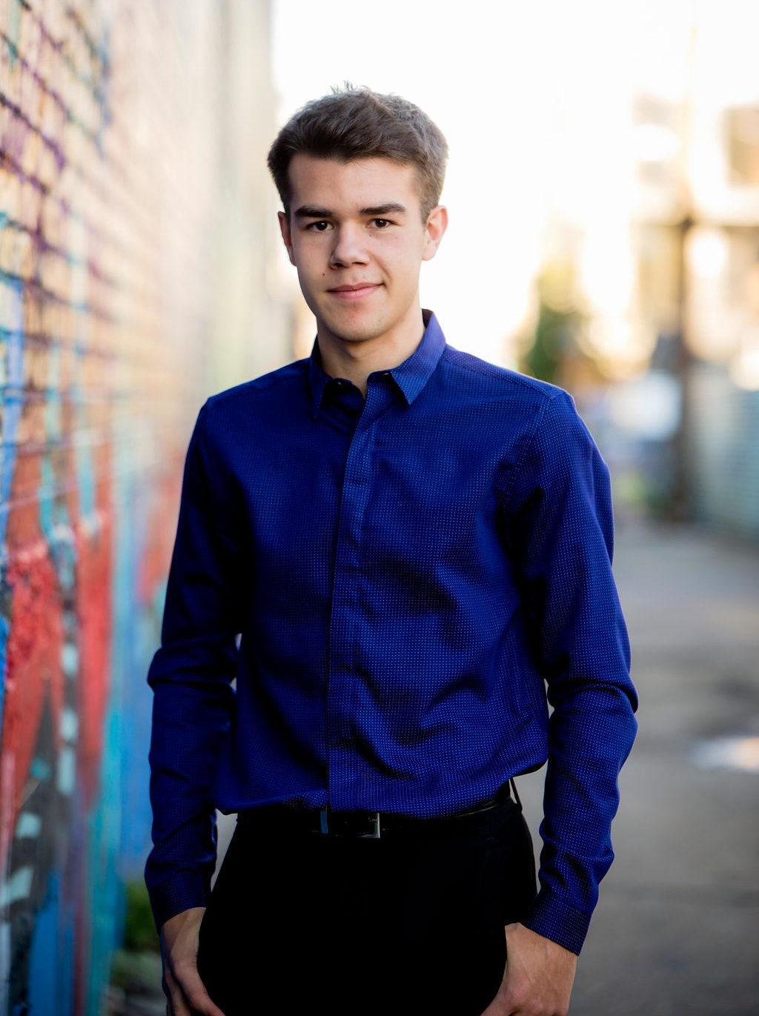
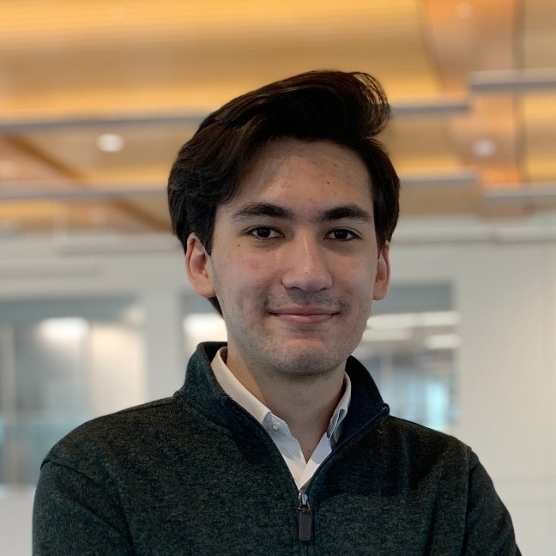
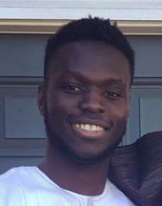
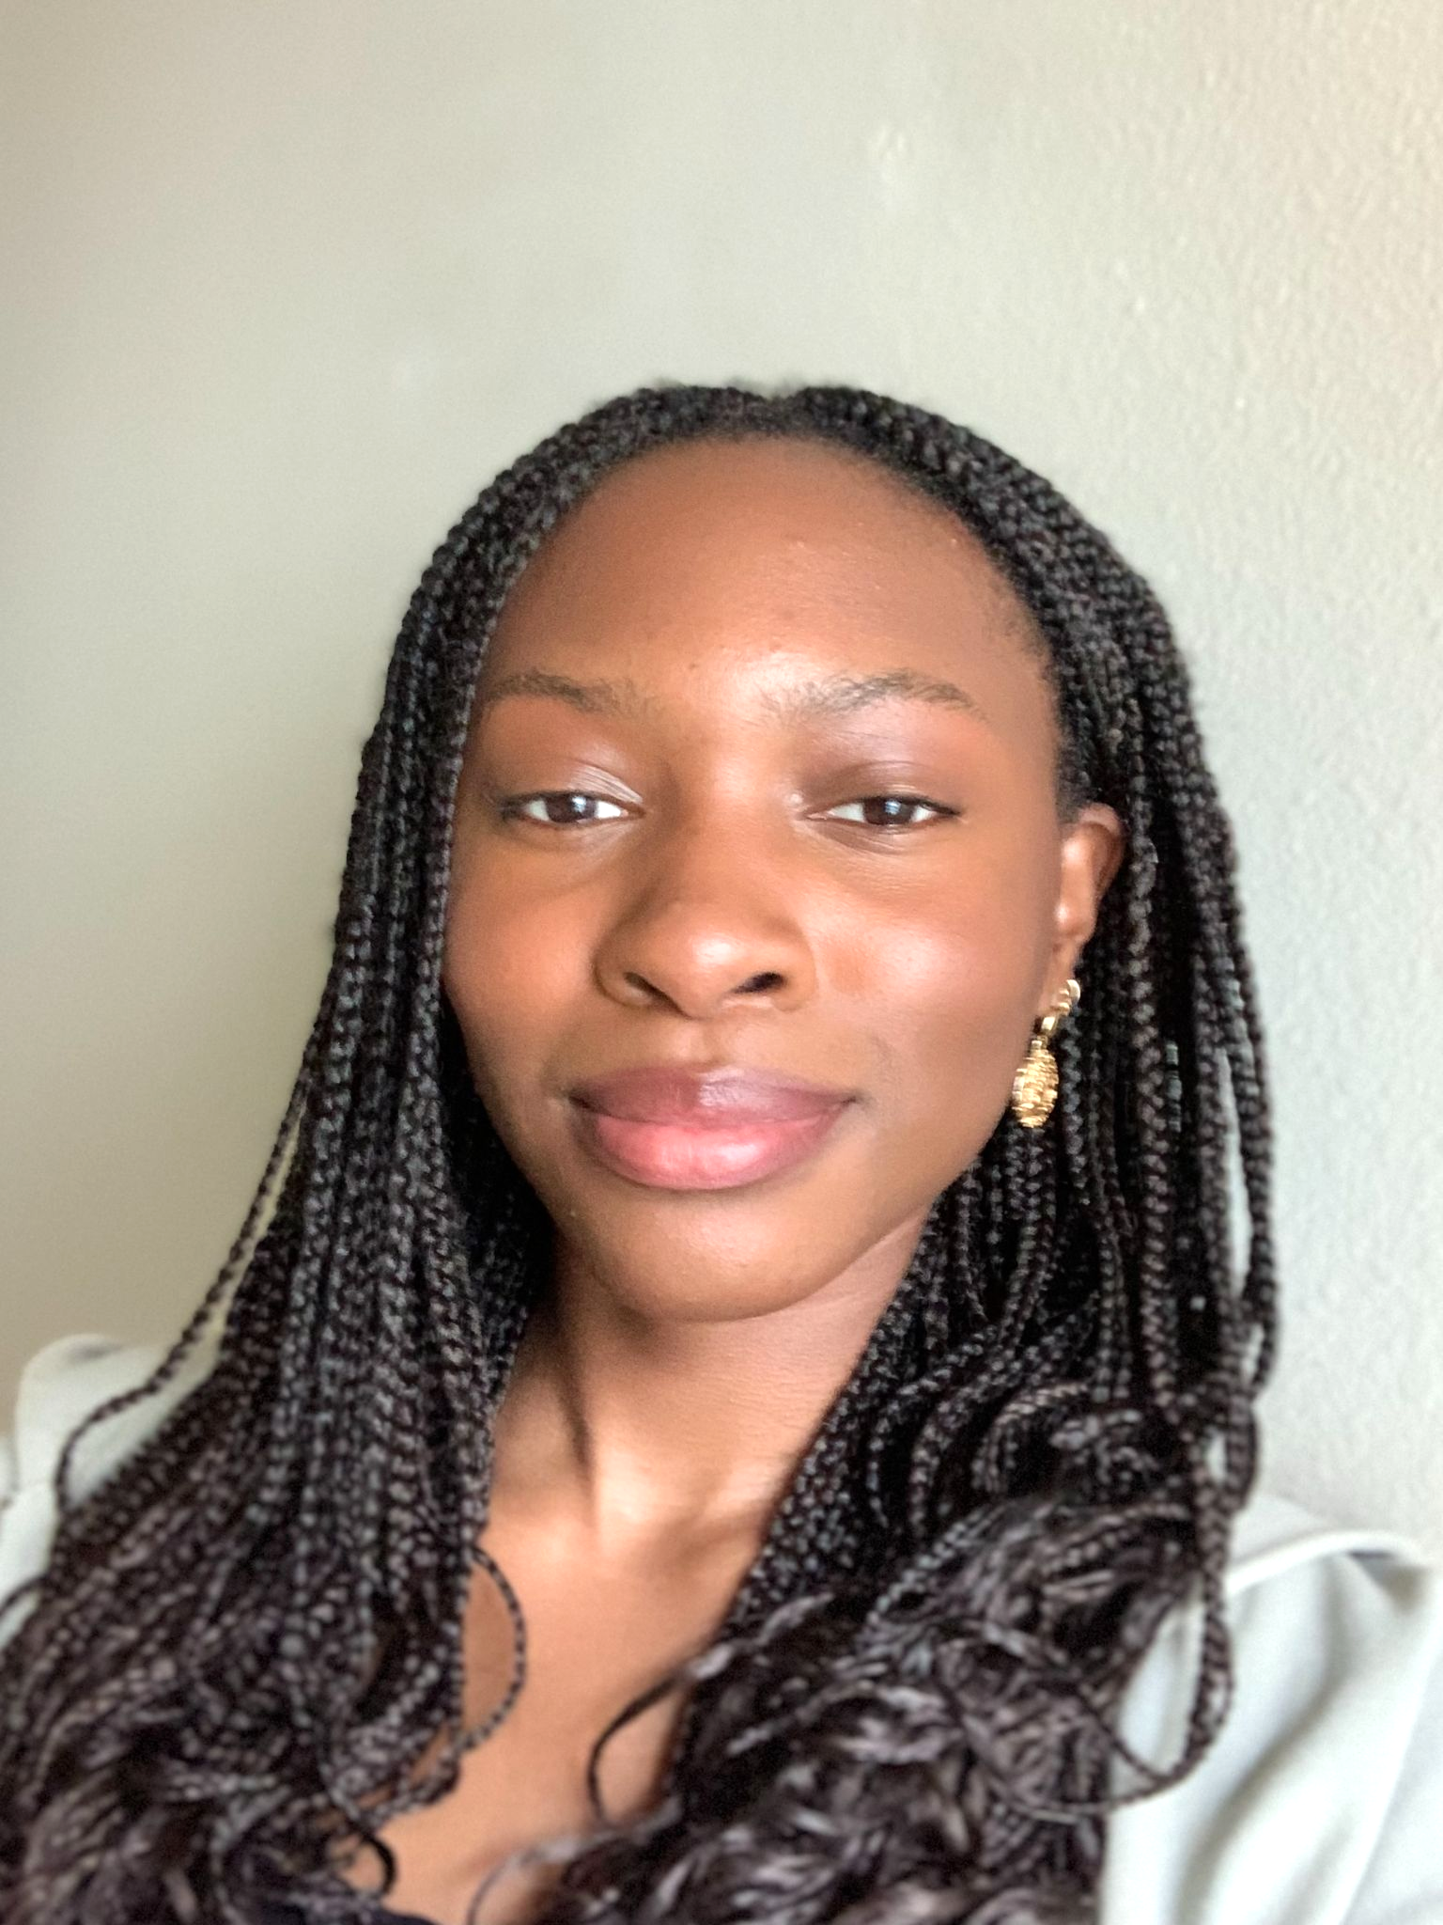
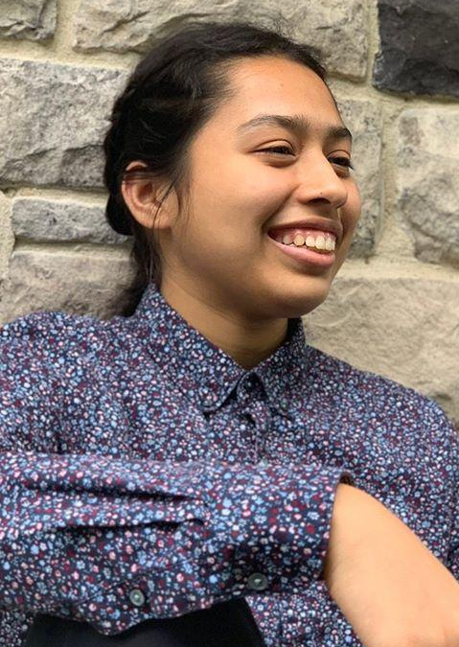
OUR TEAM
Miles Robertson
Rafael Piloto
Ore Adenikinju
Mimi Olayeye
Brenda Cano
David Wei
Product Owner
Scrum Master
Team member
Team Member
Team Member
Team member
Notes:
David

Slide 3
AGENDA
01
03
02
Acknowledging Feedback
How did we measure up to our goals?
What did we accomplish?
Notes:
David

Slide 4
01
Acknowledging Feedback
Notes:
Brenda

Slide 5
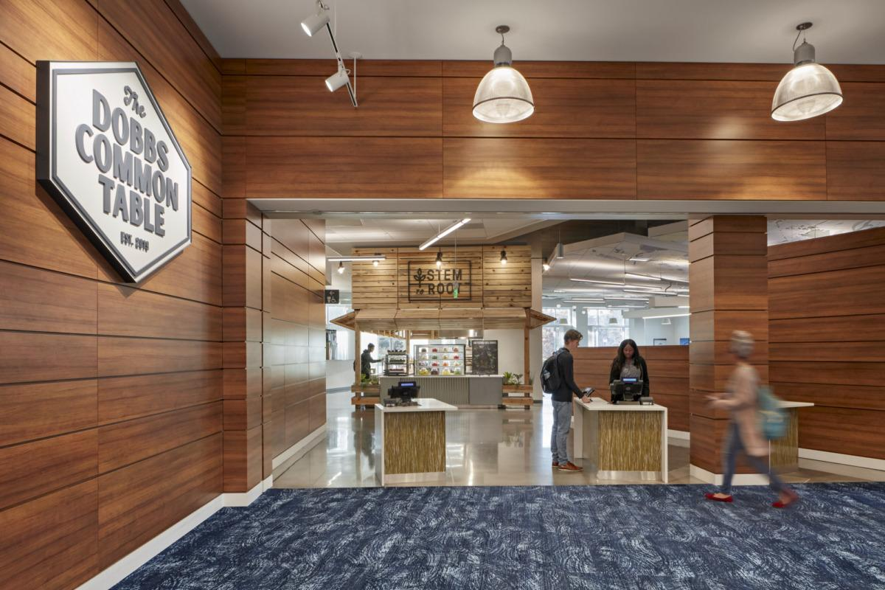
Frontend design is elegant and straightforward
Well planned progress
Gave clear explanations
Resounding support for our features such as notifications for meals, rating food, and sharing location
Addressed feedback in a clear manner
Loved our pair programming and burn down chart
And more!
Strengths / Positive Feedback
Notes:
Brenda
We wanted to take a moment to acknowledge all the strength/positive feedback we received consistently these past 10 sprints.

Slide 6
02
What did we accomplish?
Notes:
Ore

Slide 7
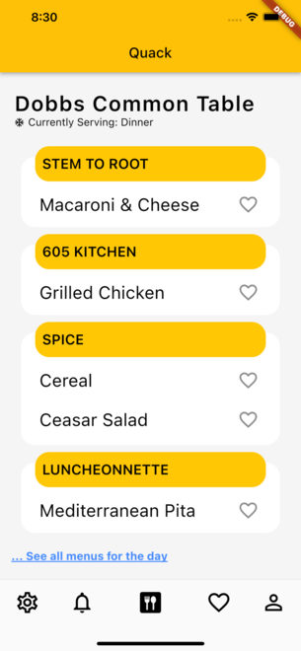
Homepage UI Updates
More visually appealing
Maintained simplistic design
Notes:
Ore

Slide 8
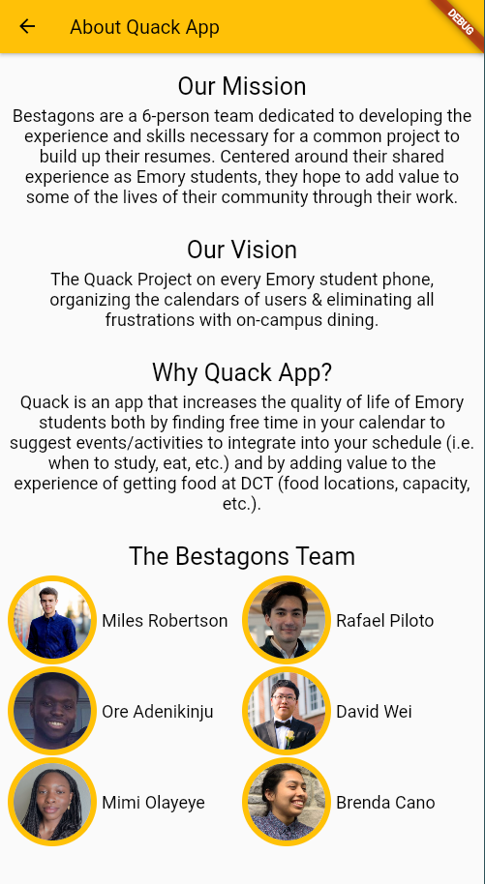
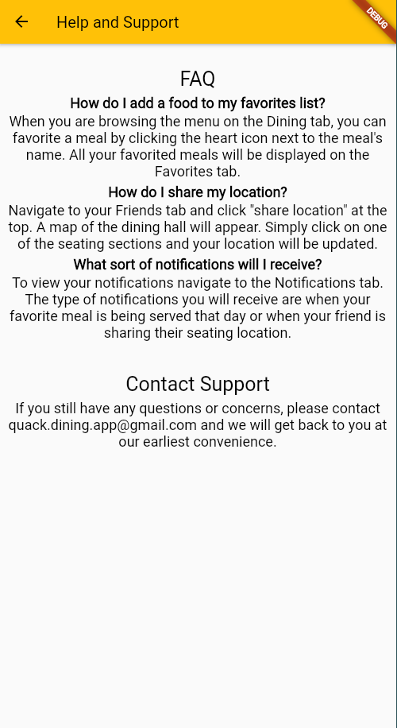
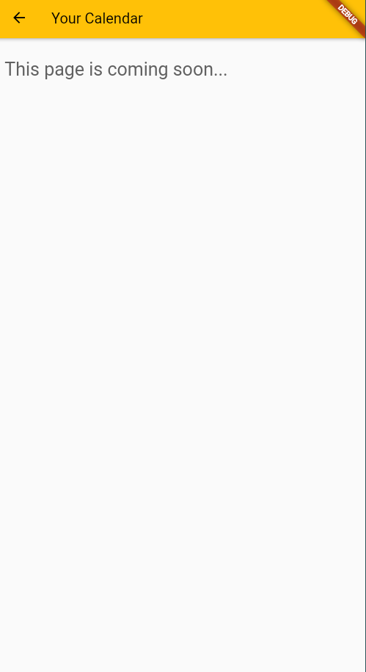
Static Pages Examples
Notes:
Brenda
We updated all of our static pages so that we have all necessary information available and so our app looks presentable for our final presentation.

Slide 9
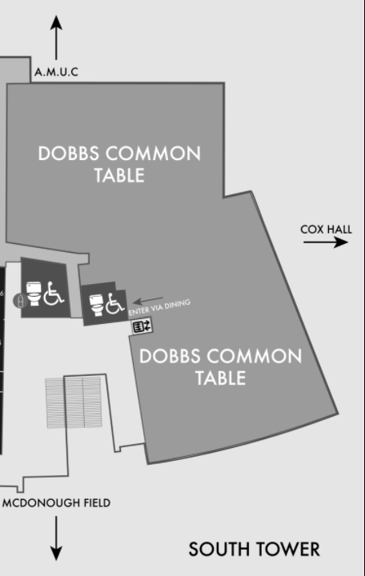
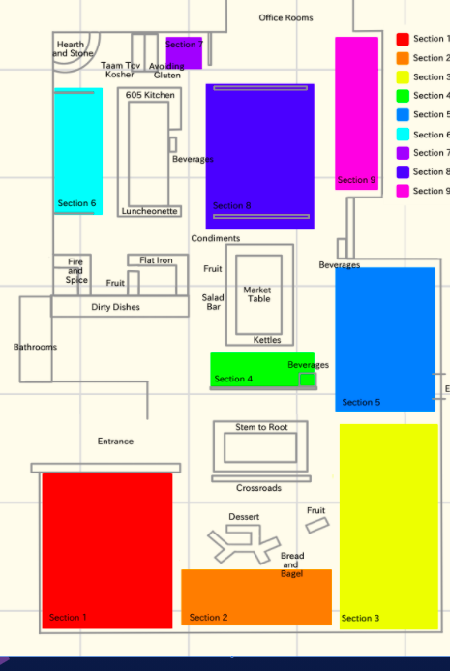
DCT Floor Plan
Labeled Map
Save Seated Section
Colored coded map of the DCT
connected to Fast API
New collection on MongoDB
Notes:
Mimi

Slide 10
Official Prod Deployments
Notes:
Rafael

Slide 11
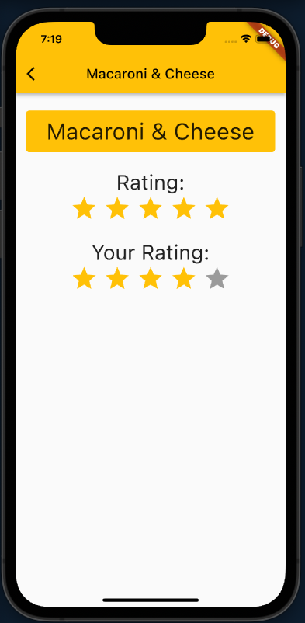
FrontEnd: Rate Food
Basic template to rate and view food ratings
Finishing touches to UI to match new app UI
Notes:
Rafael

Slide 12
Connecting the FrontEnd and Backend
JWT Integration in the Front End
Where Am I Integration
DCT Web Scraper Integrated
Routine Scheduler Probes DCT Web Scraper to update data every 12 hours
Notes:
Rafael + David

Slide 13
Connecting the FrontEnd and Backend
Connecting database to backend
Push notification devices
Favorites
Refactoring + Cleanup
Notes:
Rafael + David

Slide 14
03
How did we measure up to our goals?
Notes:
Miles

Slide 15
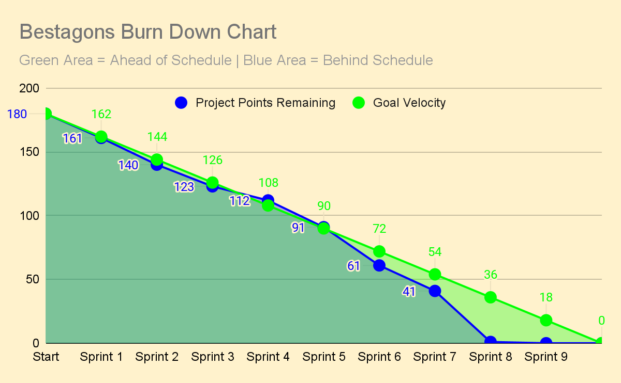
Notes:
Miles
Overshadowing

Slide 16
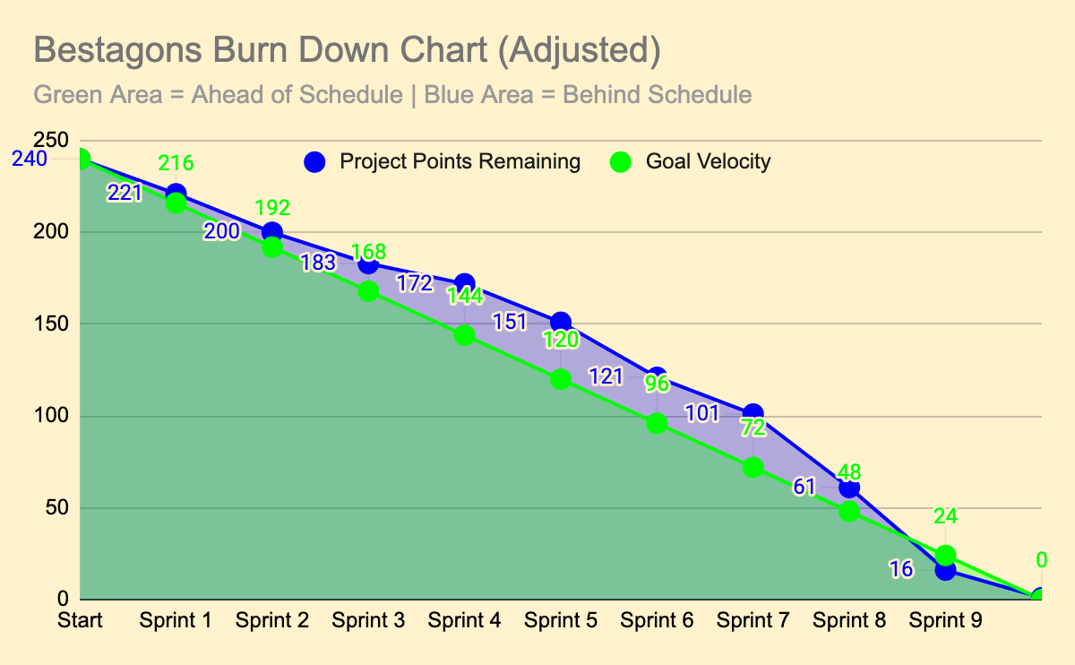
Notes:
Miles
If we had better predicted the volume of work and/or tried to beat our goal each sprint rather than meet it, might have been good, still we succeeded at scrum and maintaining consistency, so in reality this would probably look like a delayed software release so we could have a few more sprints to not rush so much
OR this might just be the result of our measurement systems that favored points counting not for all weeks worked on them, but when they were completed.

Slide 17
Final Project Showcase
Record/create video presentation with accompanying slides
Ensure our app works properly from beginning to end
Make sure our GitHub project is cleaned up and presentable
Monday, December 6th
Notes:
Miles
we will bring all of this to the showcase when we see you next Monday!

Slide 18
THANKS
Please remember to share your feedback :)

